Slide 1
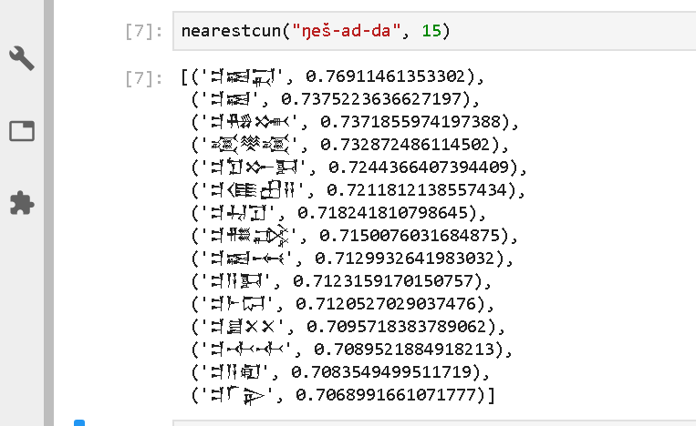
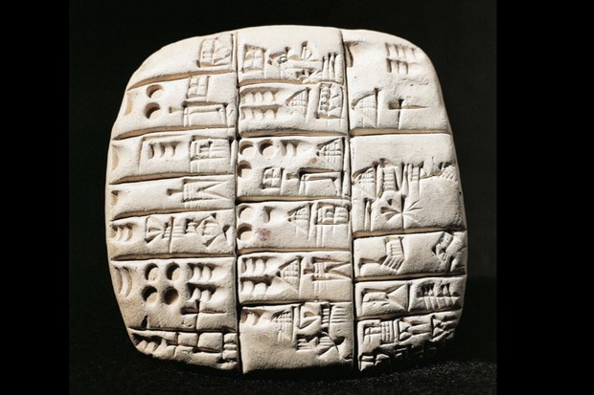
Data Science for Hard Core Humanists
Opportunities and Challenges from Computational Assyriology
Niek Veldhuis, UC Berkeley

Slide 3
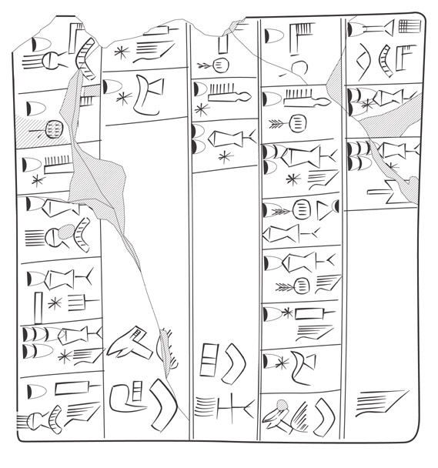
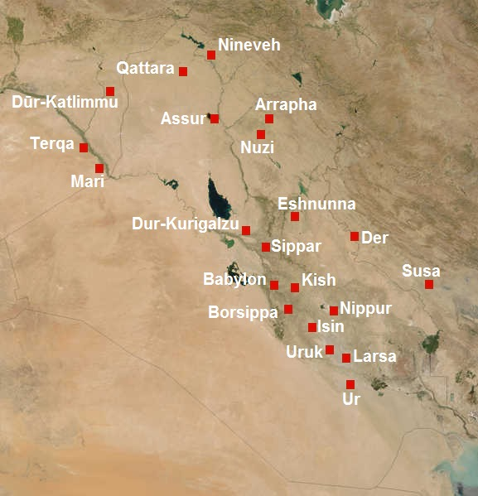
Archaic Metals Account
Notes:
https://cdli.ucla.edu/dl/lineart/P001993_l.jpg

Slide 4
Cuneiform: A History
3,200 Administrative
2,700 Royal Inscriptions
2,500 Literary (Sumerian)
2,400 Letters
1800 Divination, Literary (Akkadian)
1300 Medical
500 Astronomical Tables
0 The End

Slide 5
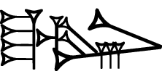
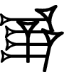
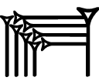
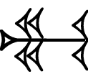
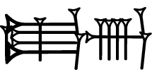
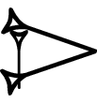
Transliteration, Lemmatization
Transliteration: lugal-e e₂ mu-un-du₃
Lemmatization: lugal[king]N e[house]N du[build]V/t
Translation: The king built the temple

Slide 6
Main Digital Cuneiform Projects
 | ETCSL | CDLI | ORACC | Archibab | SEAL | EbDA | BDTNS
Speciality | Literary | Metadata |  | Admin | Literary | Admin | Admin
Language | Sumerian |  | Sumerian Akkadian | Akkadian | Akkadian | Eblaite | Sumerian
Lemm | Yes | No | Yes | Yes | No | Yes | No
Texts | 400 | 350,000 | 150,000 | 20,000 | 900 | 3,000 | 65,000
Period | 1800 |  |  | 1800 | 1500 | 2300 | 2050
Output | XML | Raw text | JSON | PDF | PDF | HTML | Raw text
Active | 1996-2006 | 1998 - | 2006 - | 2009 - | 2008 - | 2016 - | 2002 -
Open | Yes | Yes | Yes | No | No | ? | Yes

Slide 7
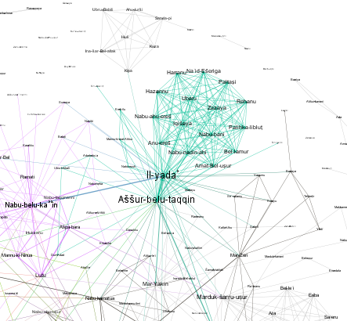
Potential
Social Network Analysis
Comparing Vocabularies
Topic Modeling
Word Embeddings
Letters to Sargon (8th Century king of Assyria)
Gephi
Notes:
Letters to Sargon with Modularity

Slide 8
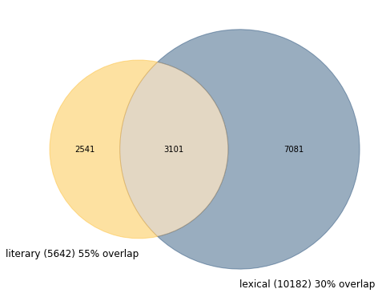
Potential
Social Network Analysis
Comparing Vocabularies
Topic Modeling
Word Embeddings

Slide 9
Potential
Social Network Analysis
Comparing Vocabularies
Topic Modeling
Word Embeddings
Visualization of words in topics
Visualization of documents in topics

Slide 10

Potential
Social Network Analysis
Comparing Vocabularies
Topic Modeling
Word Embeddings
Sumerian terminology for ship building

